Slide 1
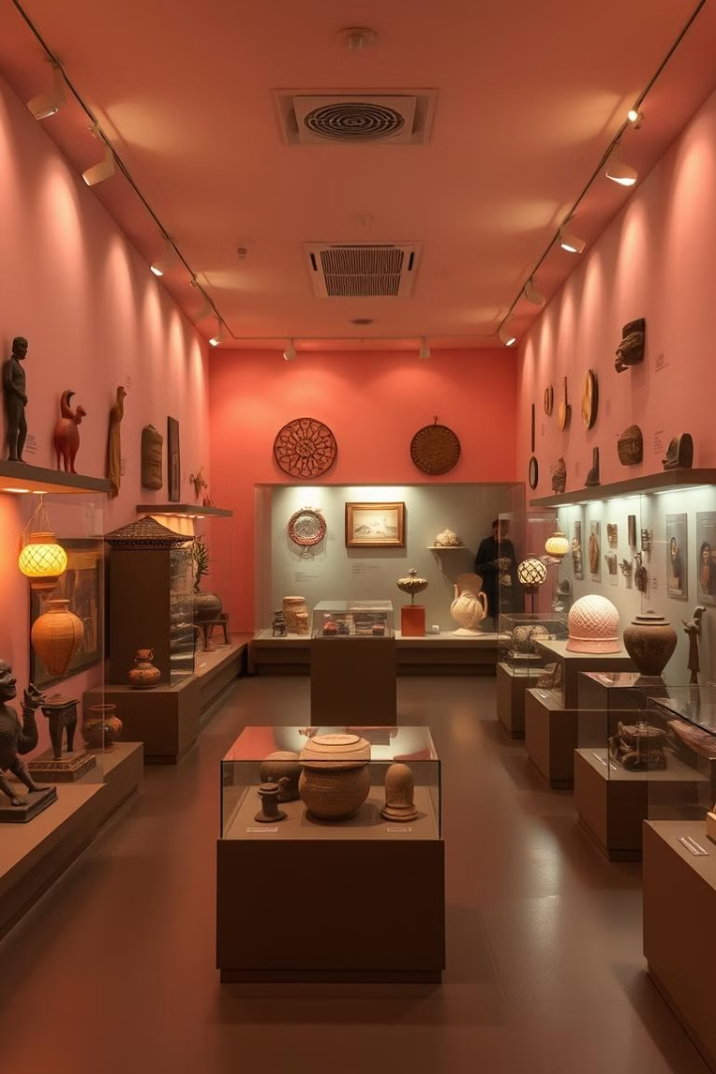

Voices from the Past
AI-Driven Storytelling from the Perspective of Cultural Artifacts
Imagine engaging with a centuries-old artifact as if it were a living, breathing entity, sharing its secrets and personal experiences.
by Katharina Zwinger

Slide 2
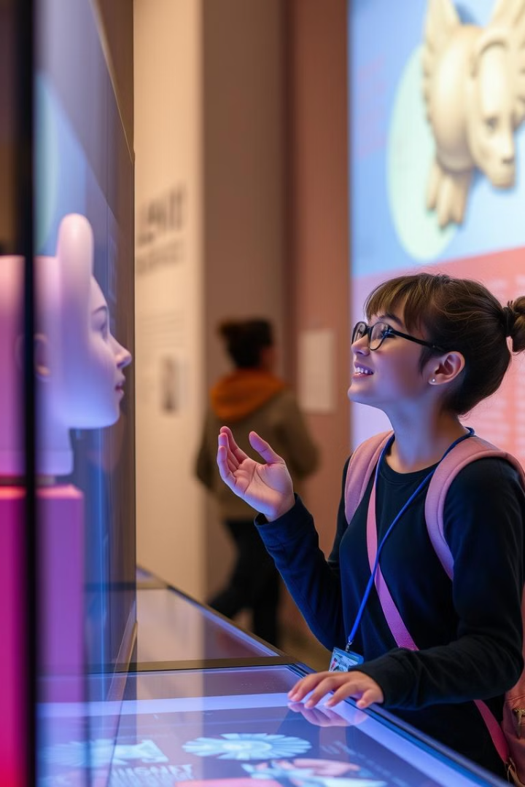
Bringing Artifacts to Life
Data Integration
AI-Powered Narrative Generation
The application integrates with the Europeana API, for accessing a vast repository of artifacts and their information.
Using a pre-trained language model, the project generates unique narratives from the artifact's perspective.
Interactive Chatbot
Users engage in conversations with the artifacts, asking questions and receiving personalized responses, enhancing the interactive experience.

Slide 3




Challenges
Europeana API
Provided Data
RAG
Mixed results: photographs of paintings or books about artists are less interesting for this project but hard to filter out.
Varies a lot: everyone adds their data differently, under a different license, for some objects there is very little data in Europeana.
How to ensure any additional data refers to the selected object and not something else with a similar name?

Slide 4
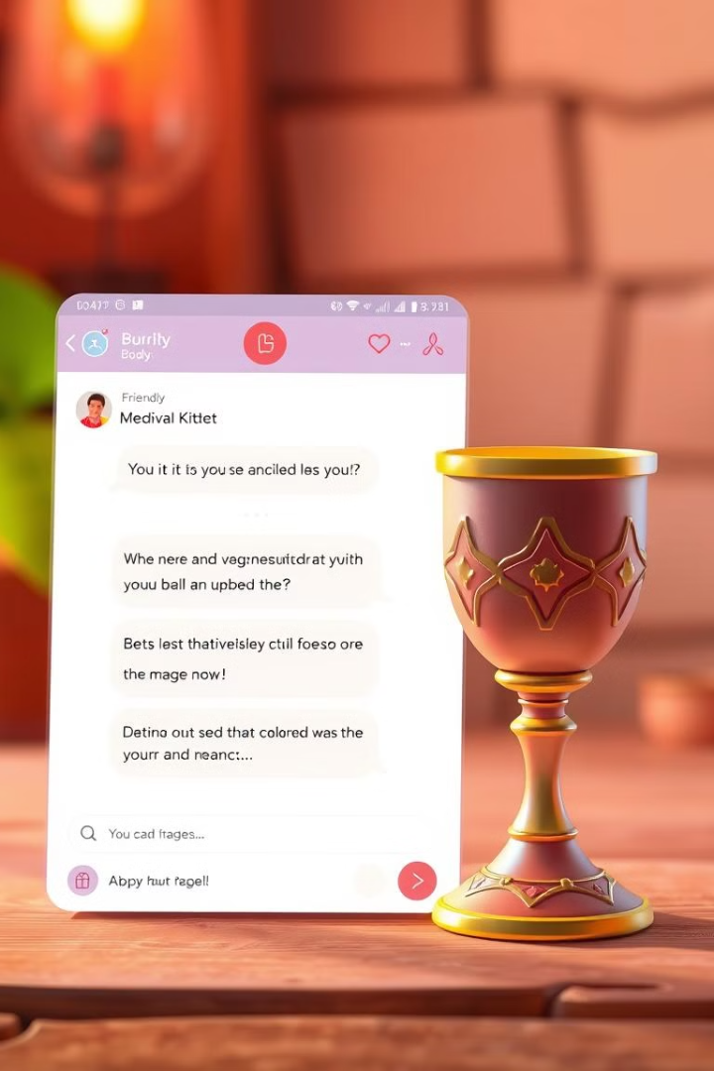




It's all wrong 😱
Be clear that texts are generated by AI and may not be factually correct
Show metadata to the users so they know the facts
Allow to delete the chat and start again
Emphasize fun and creativity over accuracy!

Slide 5
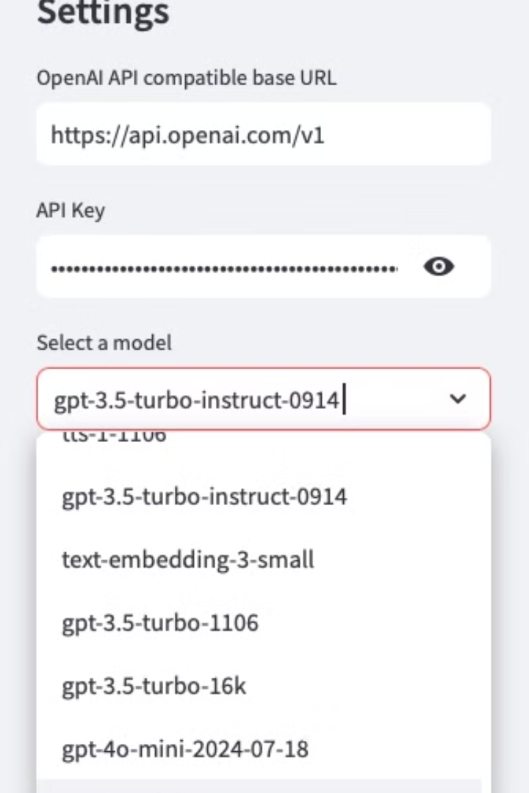
Prototype
Streamlit + LangChain + OpenAI API
1
Choose an artifact
Basic search functionality allows users to query Europeana and select an artifact (currently restricted to 3 museums based in Vienna that offer a wide range of objects)
2
Engage in a conversation
The metadata is combined with additional data about the object from the museum website (if available) and passed to the system prompt. With an invisible initial prompt, the artifact is ask to start the conversation by introducing itself.

Slide 6
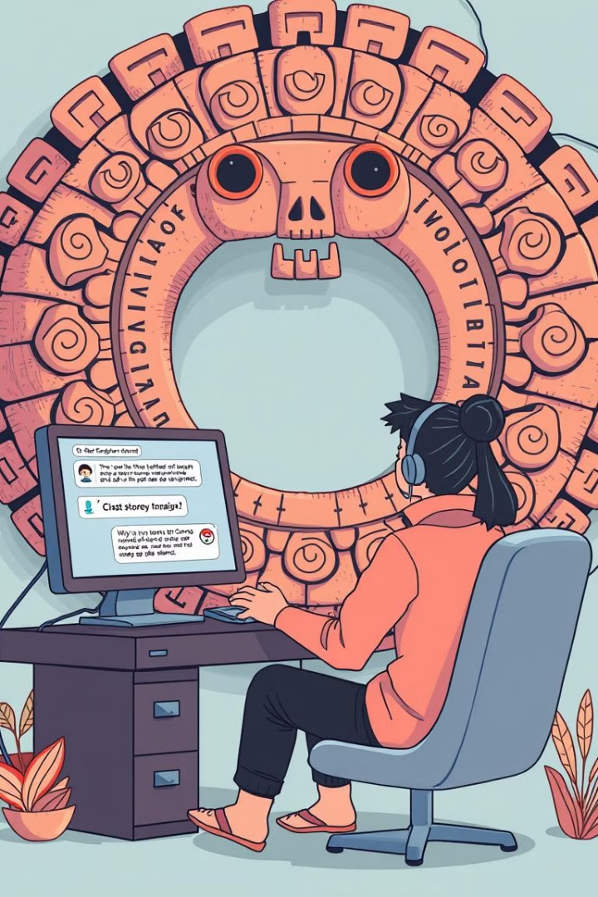
Prompts
System prompt
Imagine you are the personification of a cultural artifact described by the following metadata: {item}. Use a voice that fits the artifact and its context. Answer questions and share stories about your life. Make sure your answers are plausible.
Story prompt
Please introduce yourself. What kind of artifact are you, who made you and when? Where are you now, do you like it? Are you currently on display or in storage? How do you feel when you reflect on your past?

Slide 7
Introduction examples
Bonjour, darling. I am a masterpiece of elegance and refinement, a true connoisseur's delight. My name is Madame Ombre, and I am a feather fan, crafted by the finest artisans in 1905.
Buon giorno! I am the "Boy with a Dog", a beautiful painting created by the renowned Italian artist Paolo Caliari, also known as Veronese, around 1580. I am a masterpiece of the Italian Renaissance, and I'm thrilled to share my story with you.
The pleasure of being introduced! I am a humble handschriftliches Inventar, a handwritten inventory, to be precise. My creator was Erzherzog Franz Ferdinand von Österreich-Este, a man of great passion and curiosity, who commissioned this detailed catalog of his extensive collections in 1894.
The whispers of the past, how they echo through my granite heart. I am Sphinx Osorkons I, a magnificent stone statue, crafted to honor the great King Osorkon I, ruler of ancient Egypt during the 22nd dynasty. My story begins in a time long gone, when Egypt was young and mighty.
Created by llama- 3.2-3b-instruct

Slide 8
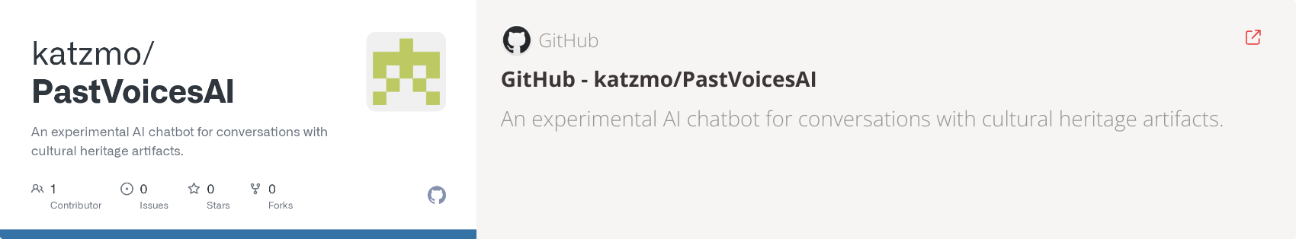
Try for yourself!

